Slide 1
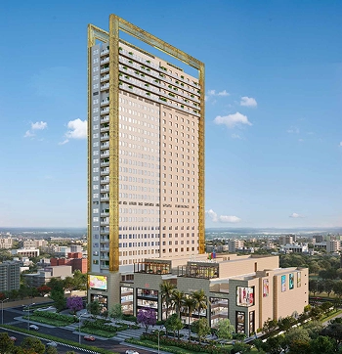
ATS Kabana High
Plot No. C-01, Sector- 04, Greater Noida (West)

Slide 2
INTRODUCTION
NO. OF FLOOR = 2 N0S. BASEMENT+ LOWER GROUND FLOOR+UPPER GROUND FLOOR + 1ST TO 29TH FLOOR
HYPERMARKET IS AT UPPER BASEMENT LEVEL.
RETAIL SHOPS FROM LOWER GROUND FLOOR TO 2ND FLOOR
RETAIL SHOPS, FOOD-COURT & CINEMA AT 3RD FLOOR LEVEL.
RESTAURANTS / PUB AT 4TH FLOOR LEVEL.
OFFICES FROM 5TH TO 29TH FLOOR LEVEL.
10000 SQ METER PLOT AREA
838 TOTAL UNITS
499596 SQ FT SALEABLE AREA

Slide 3
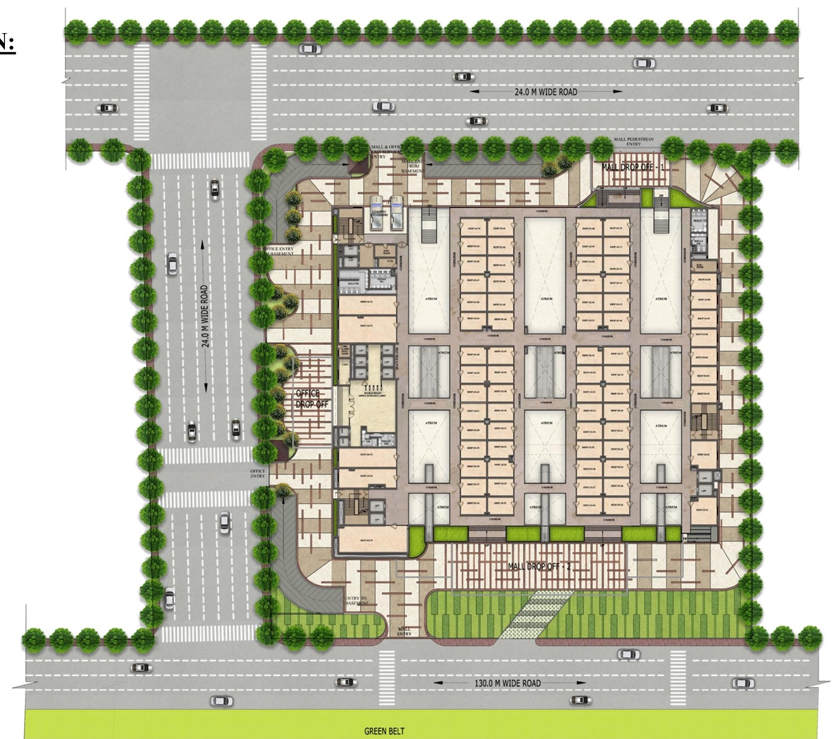
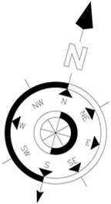
SITE PLA
N:
PLOT AREA
= 10,000 SQ.MT.
TOTAL SALEABLE AREA
= 4,99,596 SQ.FT.
TOTAL UNITS = 838 UNITS
TOTAL UNSOLD AREA = 313890 SQ FT
TOTAL UNSOLD UNITS = 459 UNITS

Slide 4
Total Retail Inventory
Floors | No of Units | Saleable area (Sq. Ft)
Lower Ground (Hyper Market) | 1 | 18936
Lower Ground Floor (Shops) | 82 | 47671
Ground Floor | 74 | 32192
First Floor | 75 | 33519
Second Floor | 78 | 36368
Third Floor | 25 | 21134
Third Floor (Multiplex) | 4 | 30657
Total | 339 | 220477

Slide 5
Saleable Inventory in Retail
Floors | No of Units (Unsold) | Area Unsold (Sq Ft)
Lower Ground | 61 | 36,518
Upper Ground | 13 | 6,862
1st Floor | 31 | 14,598
2nd Floor | 68 | 32,508
3rd Floor | 17 | 10,864
Grand Total | 190 | 1,01,350

Slide 6
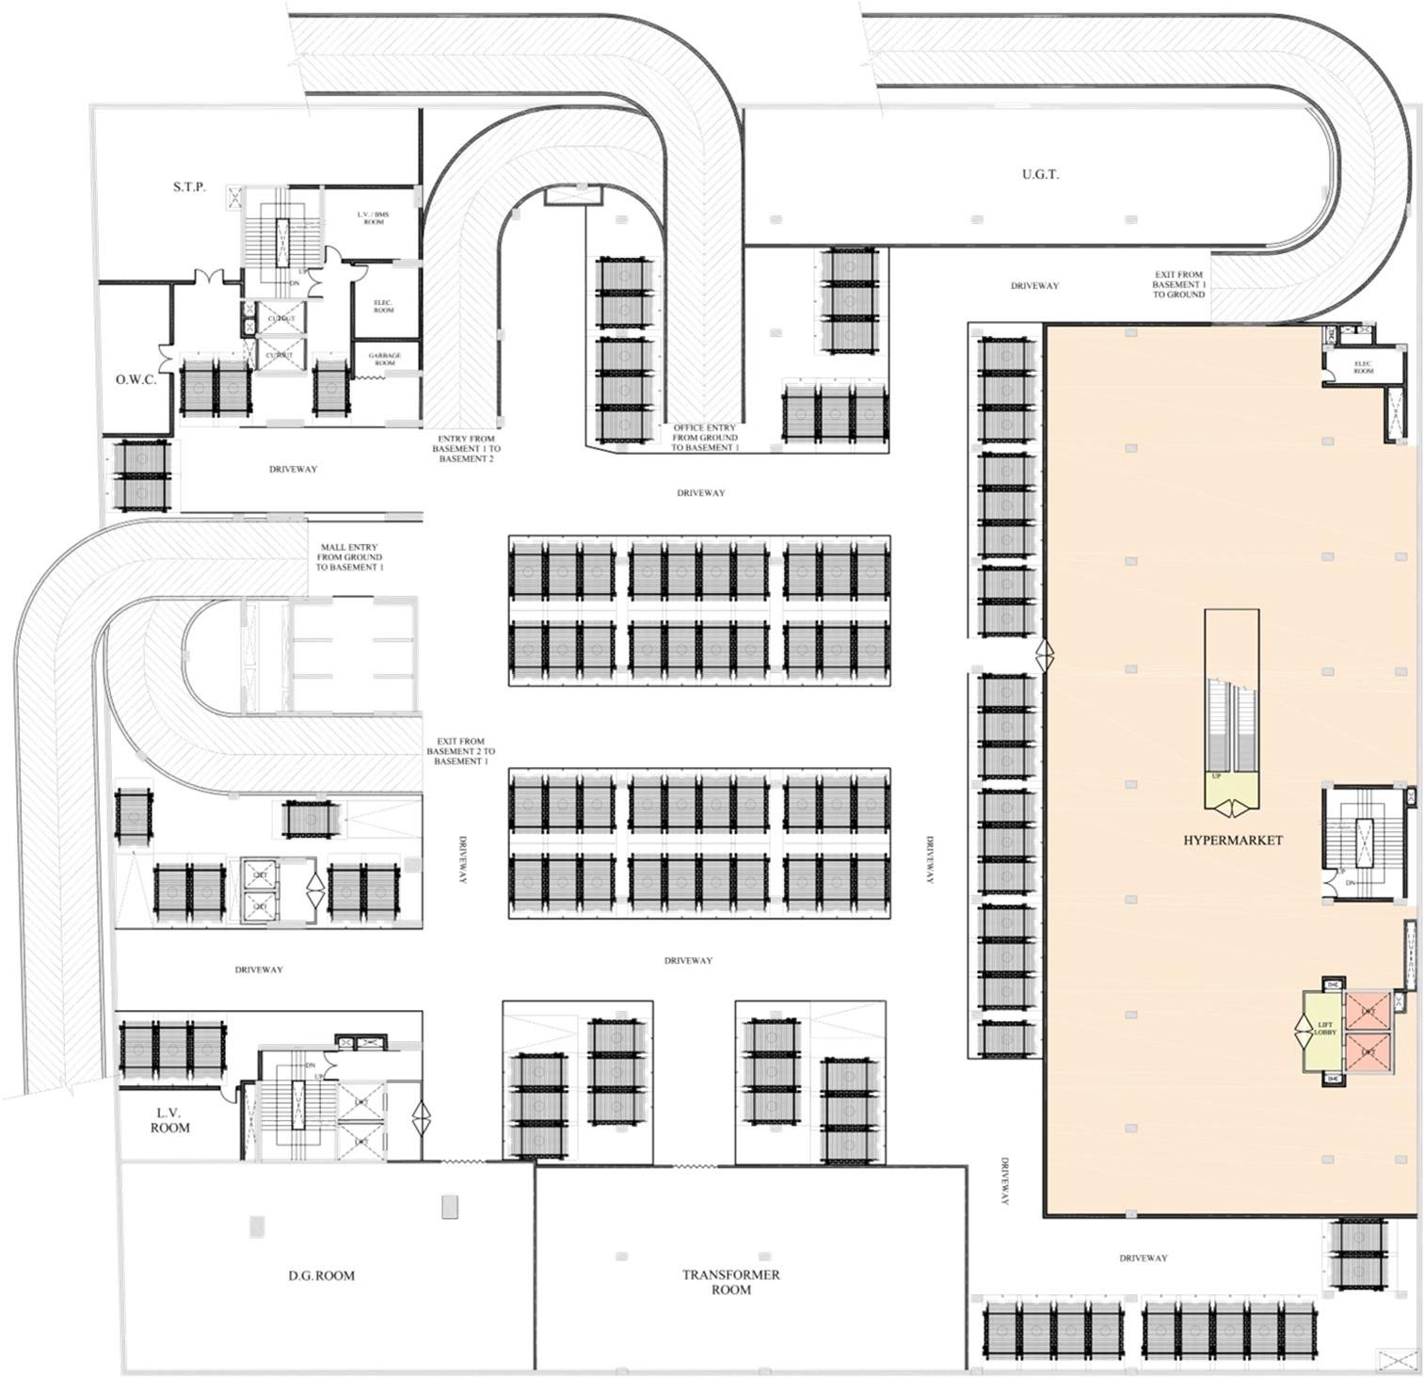
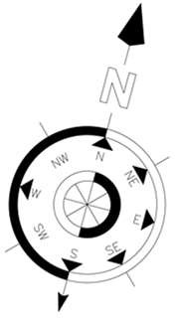
UPPER BASEMENT PLAN:
HYPER MARKET SALEABLE AREA = 18936 SQ.FT.

Slide 7
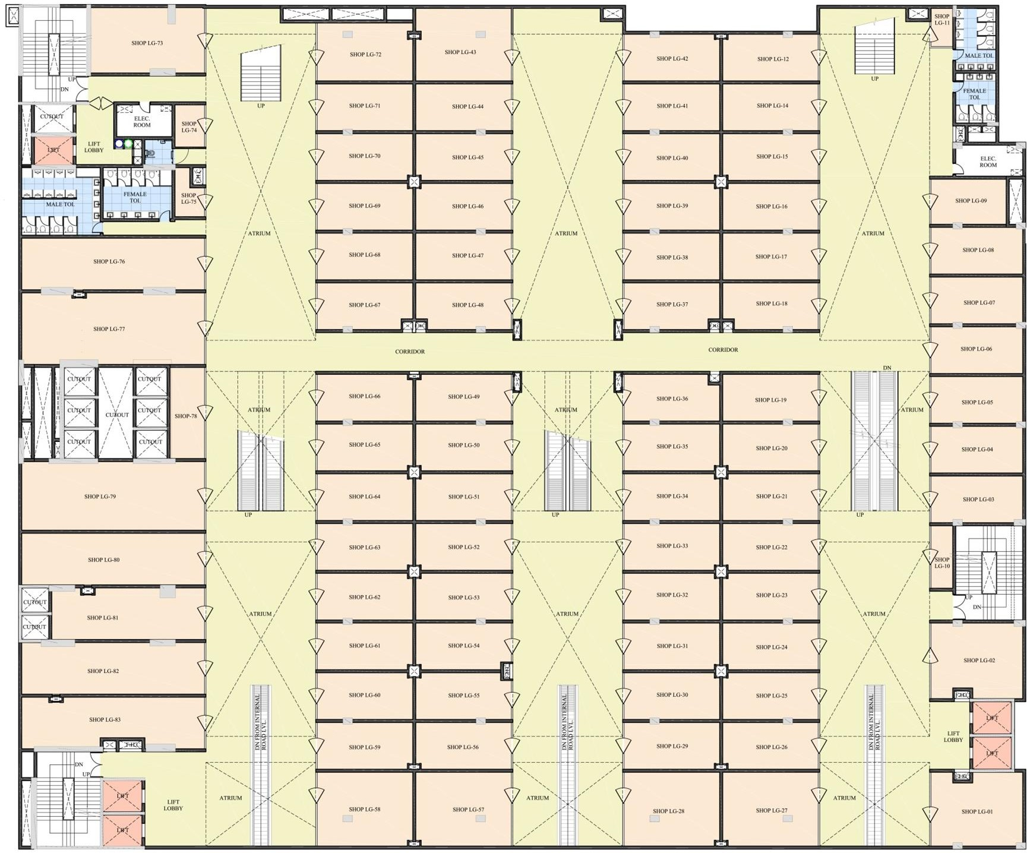
LOWER GROUND FLOOR PLAN:
NUMBER OF SHOPS = 82 SALEABLE AREA = 47692 SQ.FT.

Slide 8
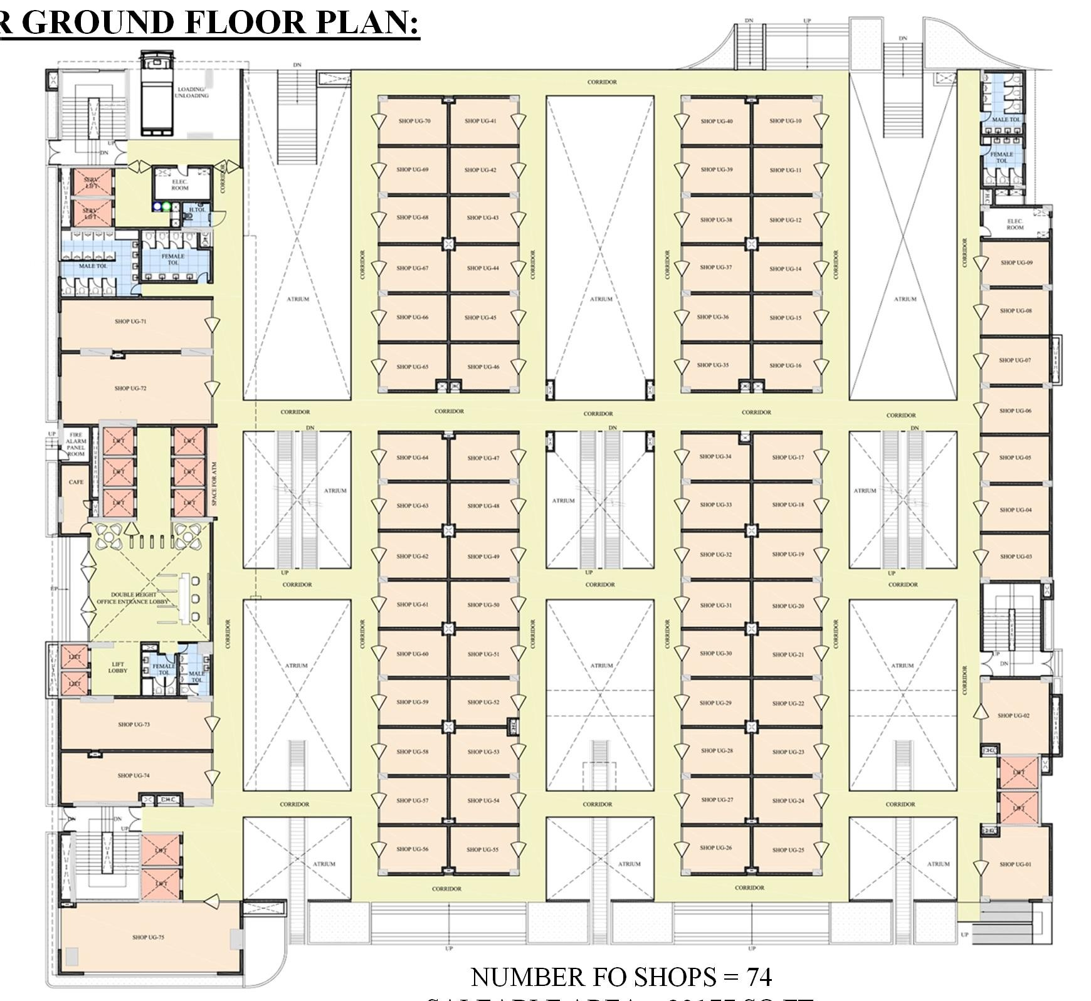
UPPER GROUND FLOOR PLAN:
NUMBER FO SHOPS = 74 SALEABLE AREA = 32177 SQ.FT.

Slide 9
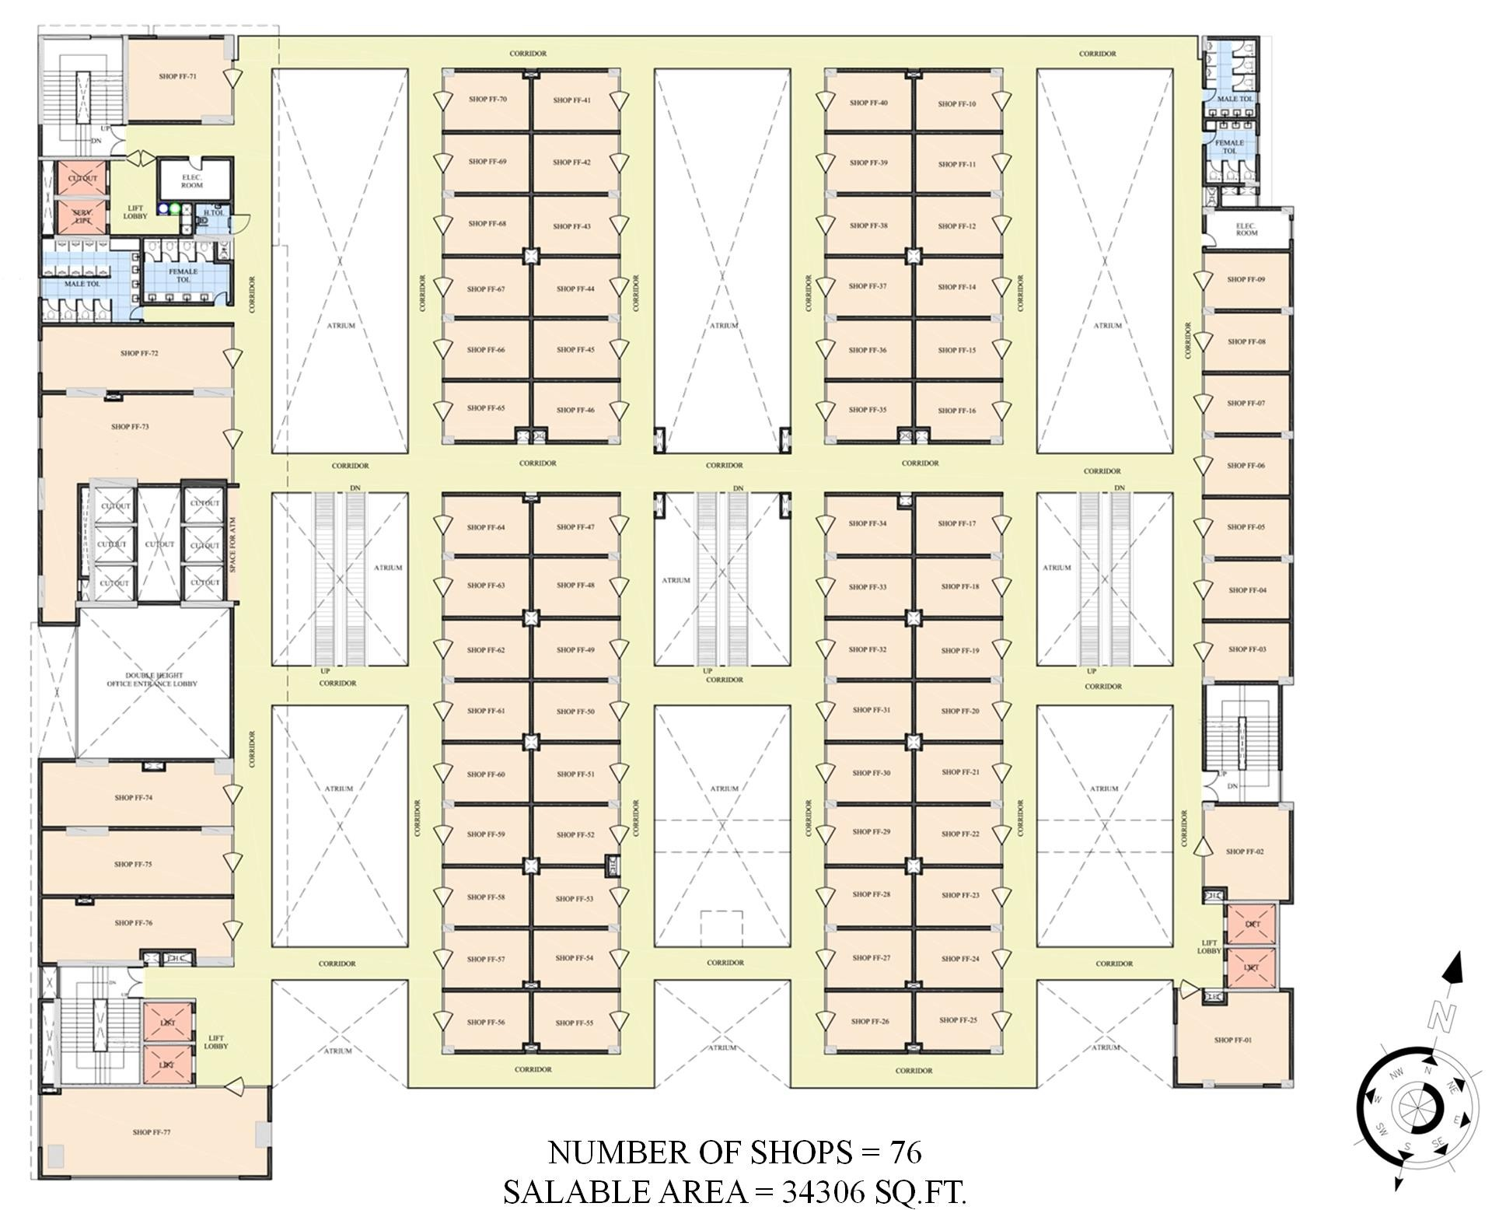
FIRST FLOOR PLAN:
NUMBER OF SHOPS = 76 SALABLE AREA = 34306 SQ.FT.

Slide 10
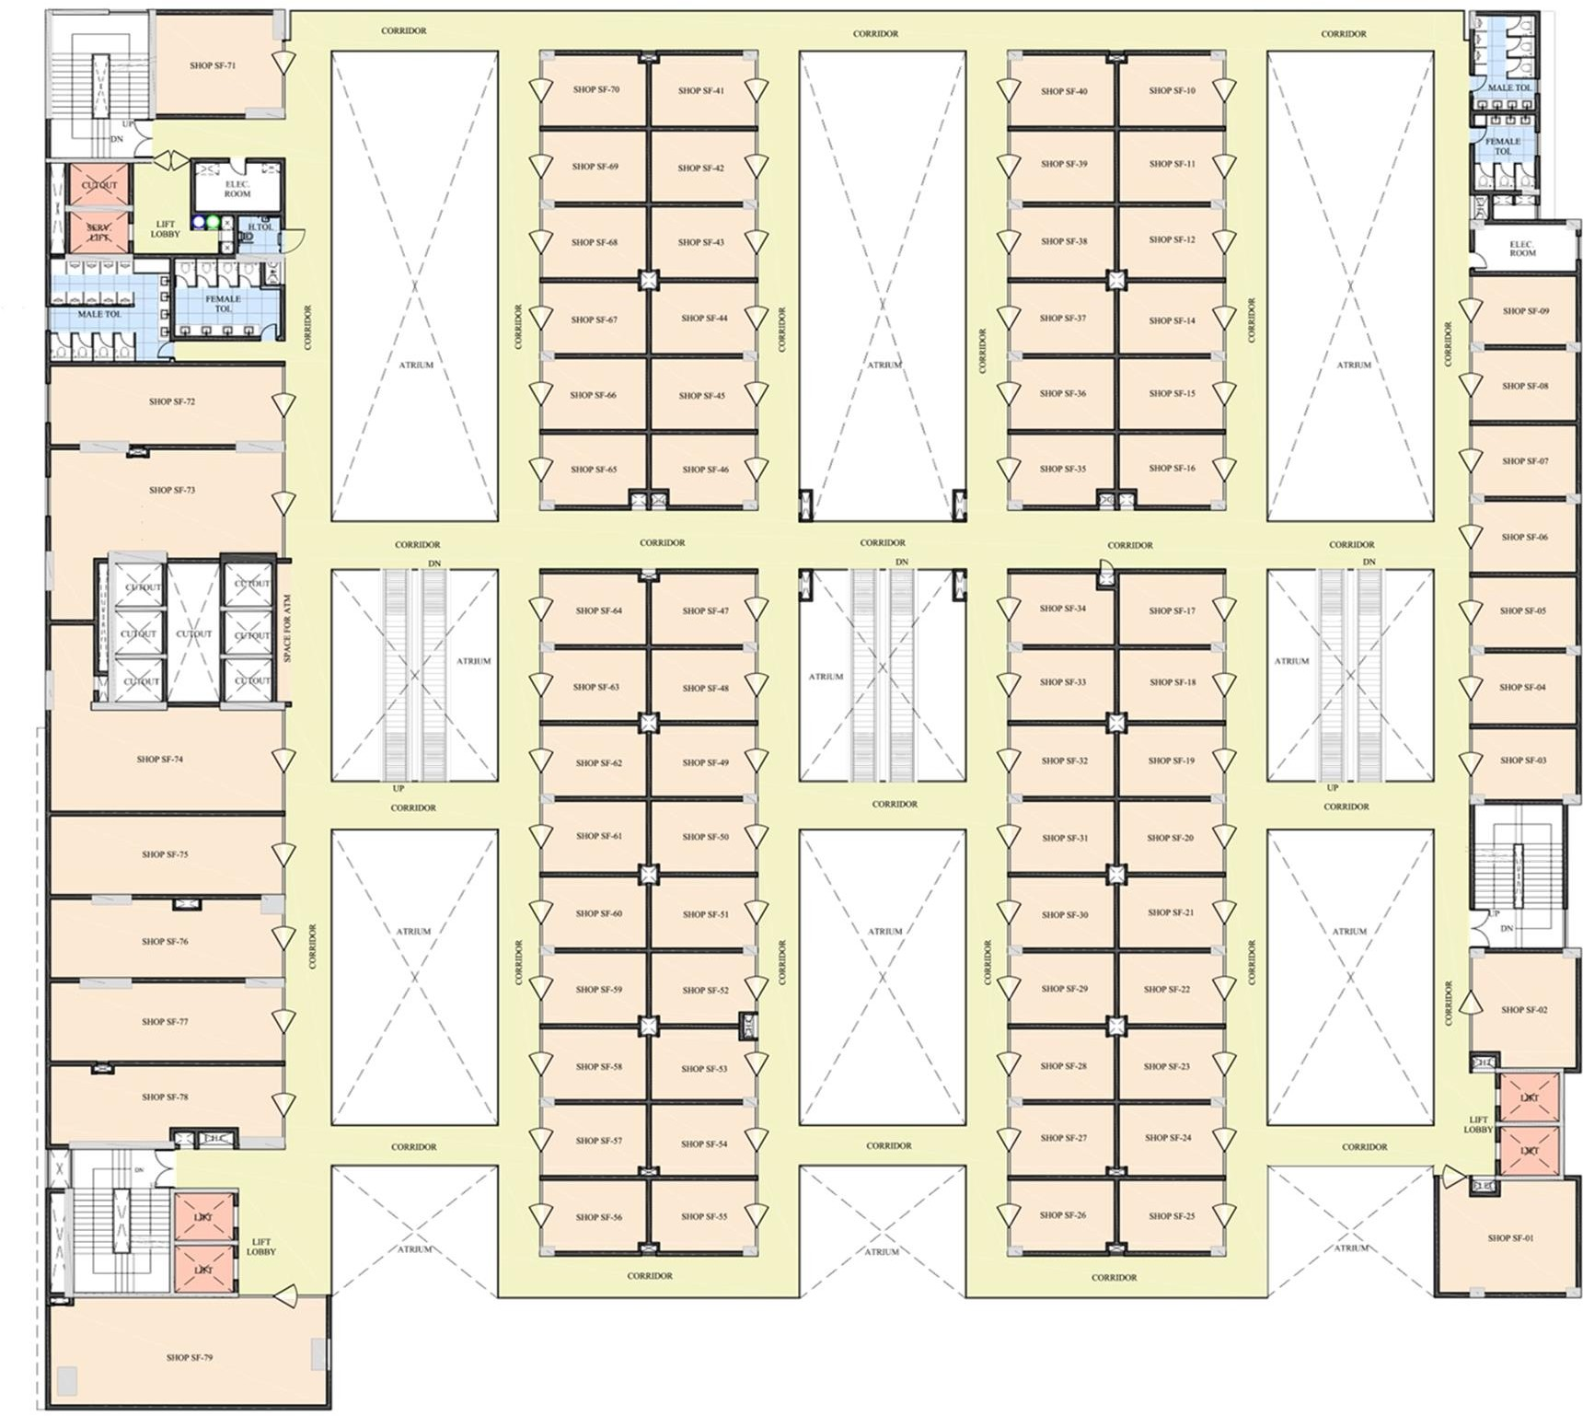
SECOND FLOOR PLAN:
NUMBER OF SHOPS = 78 SALEABLE AREA = 36352 SQ.FT.

Slide 11
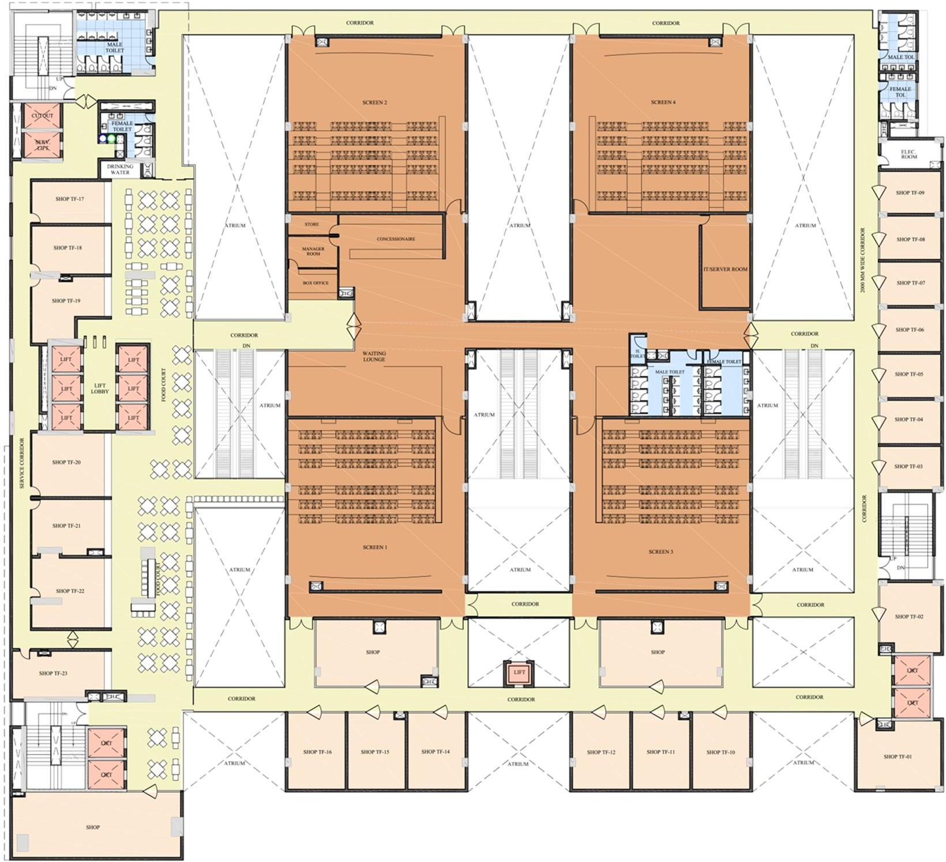
THIRD FLOOR PLAN:
SHOPS, FOODCOURT & CINEMA SALEABLE AREA = 51818 SQ.FT.

Slide 12
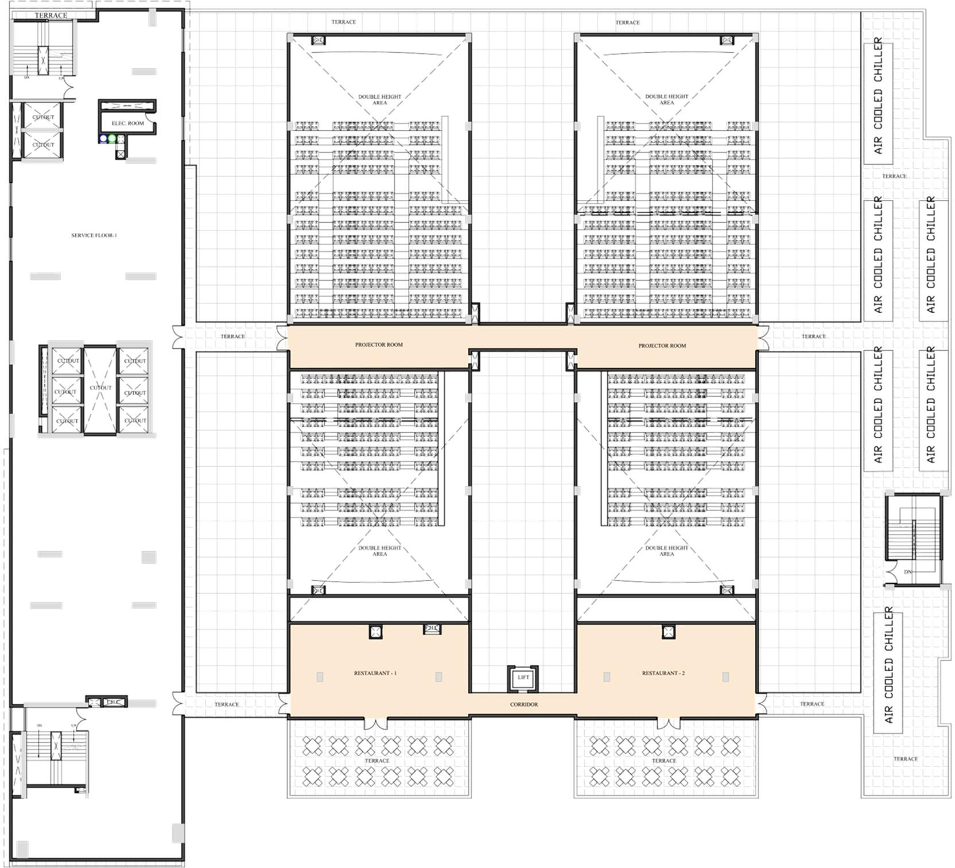
FOURTH FLOOR PLAN:
2 NOS. RESTAURANT / PUB SALEABLE AREA = 5854 SQ.FT.

Slide 13
Other Charges
1 Car Parking (optional) | Rs.3,00,000/- + GST
Power Backup | Rs. 25,000 Per KVA + GST
EMC Charges | Rs.25,000 + GST
Additional Power Grid | Rs. 40,000 Per KVA + GST
IFMS | As applicable
Maintenance | As applicable
GST | 6%

Slide 14
Assured Return Scheme
Retail Floors | Assured Return
Lower Ground Floor | Rs. 150/sqft
Upper Ground Floor | Rs. 175/sqft
First floor | Rs. 120/sqft
Second Floor | Rs. 125/sqft
Third Floor | Rs. 100/sqft

Slide 15


